Slide 1
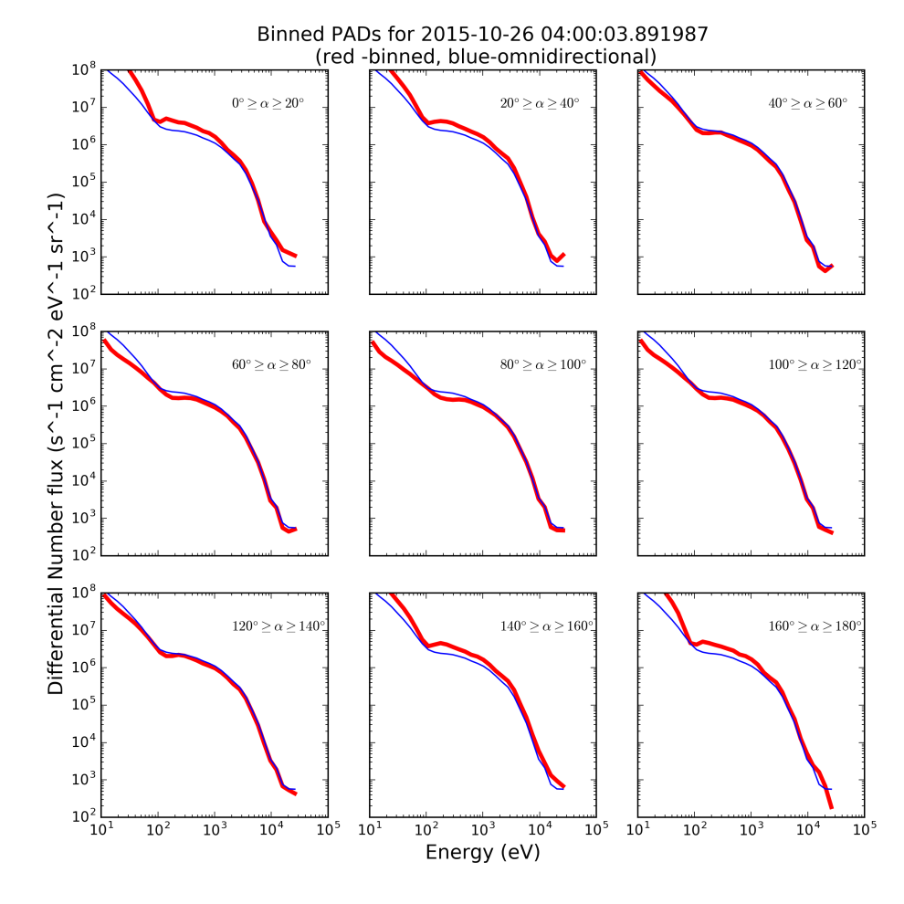
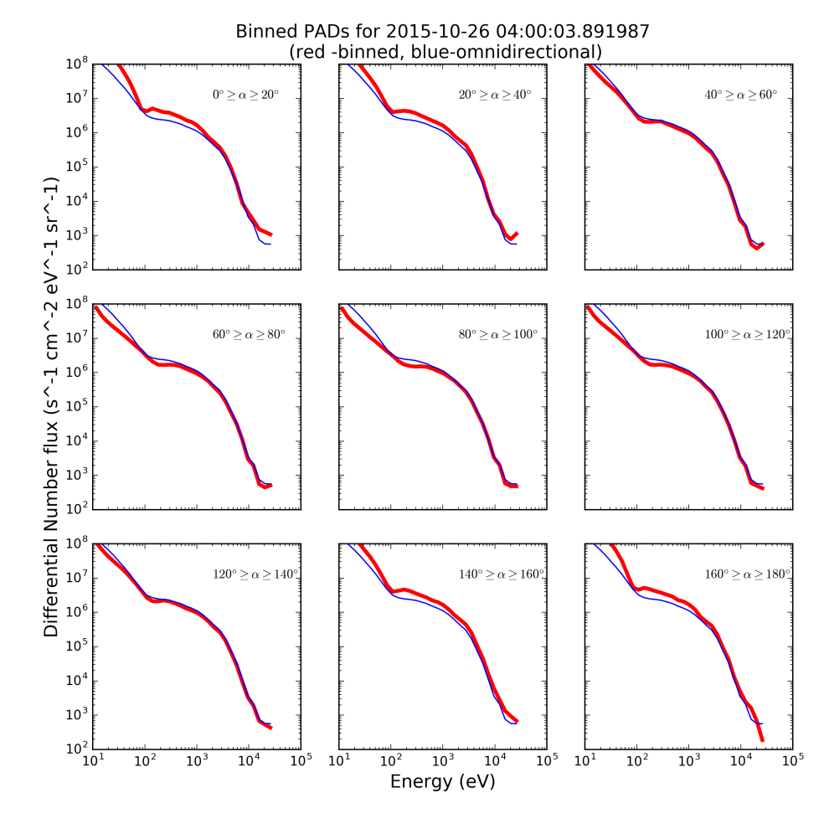
Corrected
Uncorrected

Slide 2
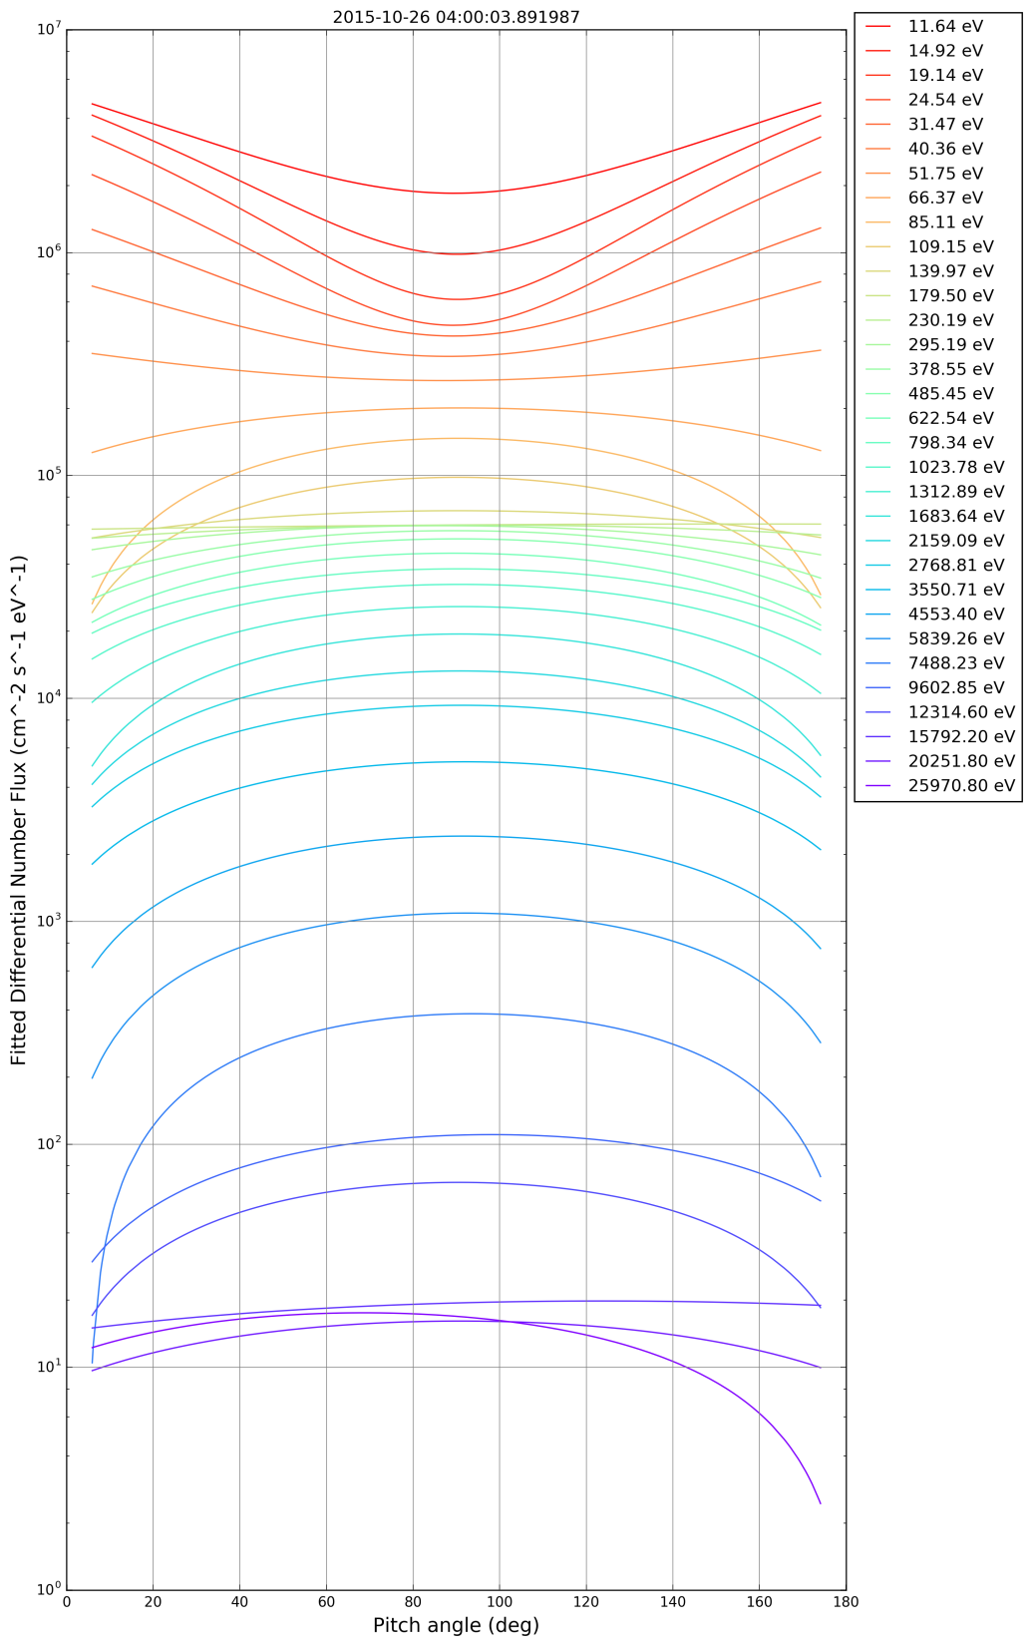
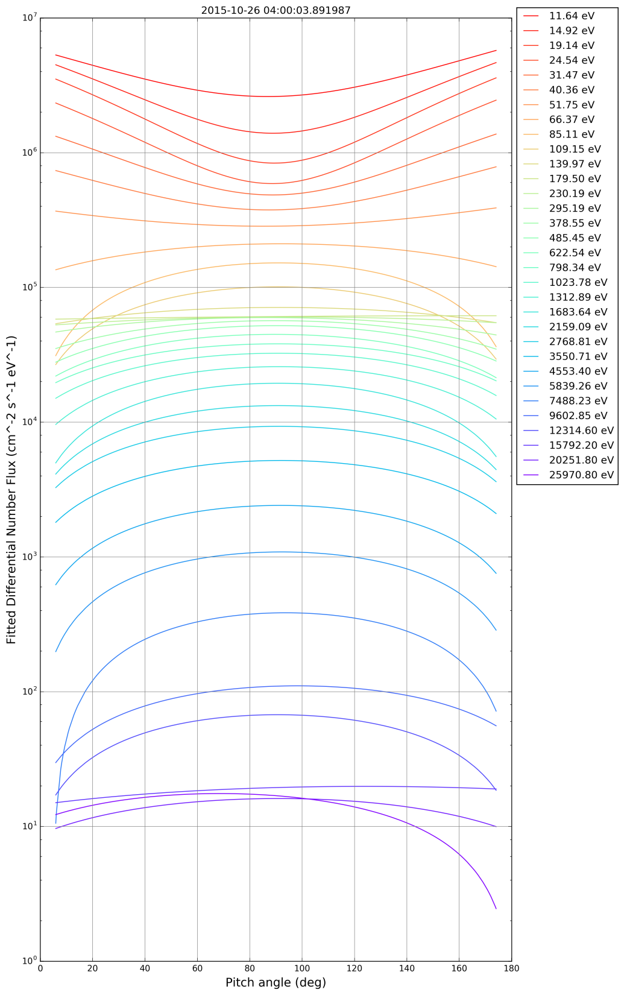
Corrected
Uncorrected

Slide 3
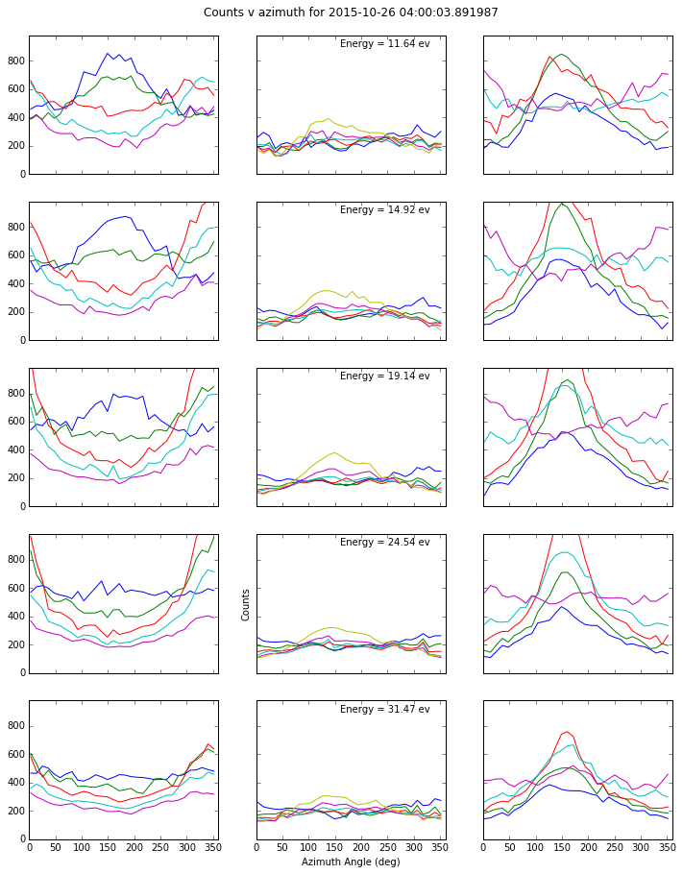
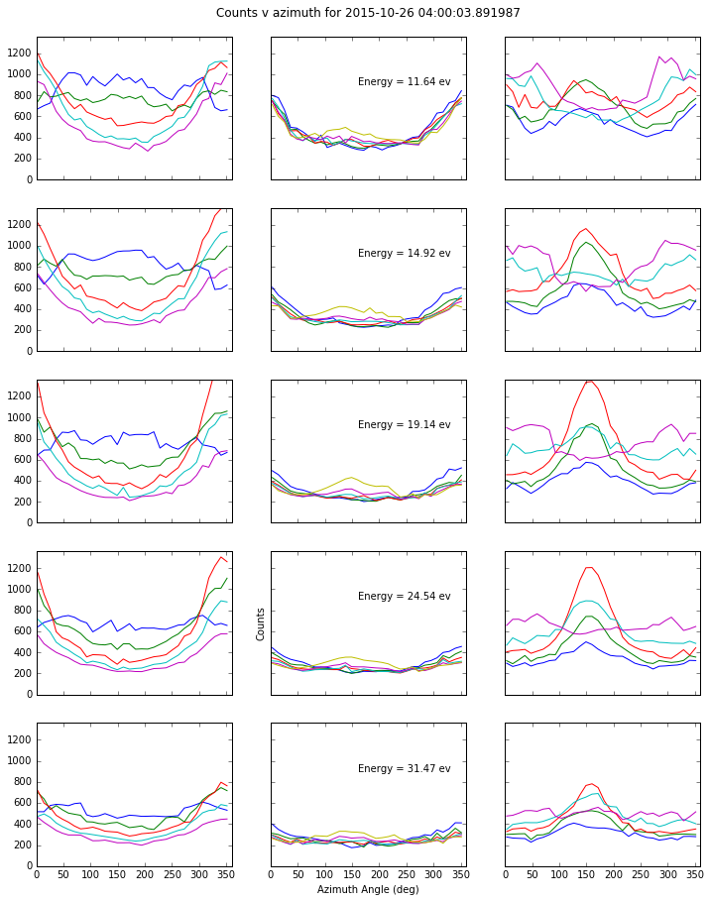
Corrected
Uncorrected

Slide 4
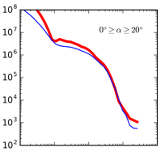
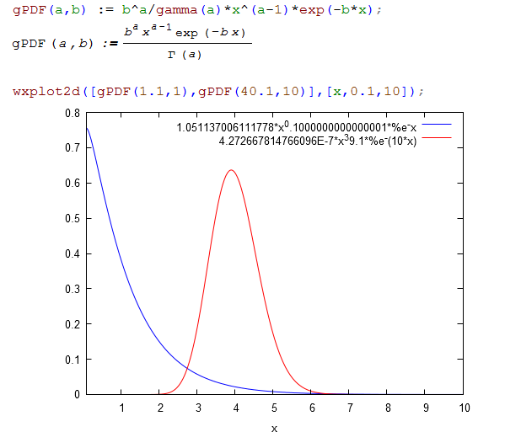
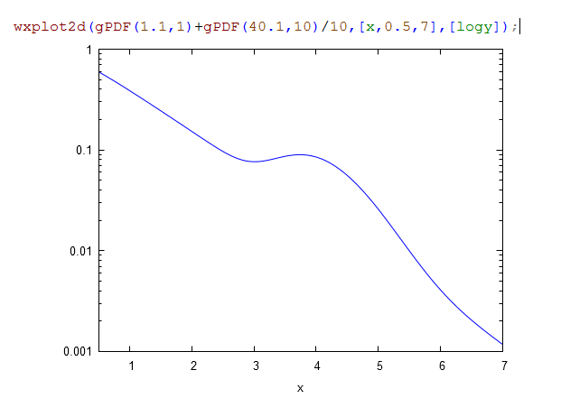
Fitting of the Differential Flux Spectrum
Possibly use a gamma distribution
With two populations

Slide 5
Ionospheric FootPrint
Tracking down how to trace observation point back to ionosphere.
MMS ‘MEC’ files seem to have that information
working on using it and understanding how it is computed (accuracy, model, etc.)

